Slide 1
Psychometric Test for Pakistan

Slide 2
Who Are We?
Sarim Zafar (Geek would be an understatement)
Ammar Ahmed (MetalHead would be an understatement)
Shahzaib Javed (Adventurer would be an understatement)

Slide 3
Problem Domain
Measure and validate the mental capabilities of an individual. In context and culture of Pakistan, what are the ways to identify the cognitive abilities of a person that match the requirements of a specific role?

Slide 4
Some of the Questions
When was the last time you gave a test?
How did it go?
Were you able to succeed?
Did you switch your field after the test?
Can you summarize your journey from that test and onward?
What do you do now?
Do you think these tests are good representative of a person abilities?
What do you think about NTS and entry tests for universities across Pakistan?

Slide 5
Interviewee 1
NAME: Ali Jibran
REASON FOR INTERVIEW: Performed good in the tests
PLACE OF INTERVIEW: Skype
METHOD OF RECRUITMENT: Contacted by phone
Student and part time software developer

Slide 6
Say
Think
Entry tests are a good representative but of a very small number of fields and skill sets
NTS is a big shame and I am grateful that its operations have halted
There should be a functioning authority that prevents anything like NTS.
Regulations for testing exams relevant to the field
Do
Feel
Sarcastic, against the evaluation system in Pakistan
Was looking forward to a major overhaul
Disappointed in current evaluation system

Slide 7
Interviewee 2
NAME: Bilal Hanif
REASON FOR INTERVIEW: Performed bad in the tests
PLACE OF INTERVIEW: Skype
METHOD OF RECRUITMENT: Contacted by phone
Project Manager

Slide 8
Say
Think
NO!... Not at all. Come on look at me, I was terrible in the exams but i think I turned out alright
I have dyslexia
Yes I switched my field
A specific rather than generic test should be taken according to candidate's choice of field
Do Not provide handicap it makes us feel bad
Do
Feel
Interested, while having a conversation about evaluation system in Pakistan
With a little bit of initiative it can be improved by a huge margin

Slide 9
Interviewee 3
NAME: Babar Sarfraz
REASON FOR INTERVIEW: Very good in tests
PLACE OF INTERVIEW: Skype
METHOD OF RECRUITMENT: Contacted by phone
CTO Human Resources

Slide 10
Say
Think
It depends on which tests you are talking about. For example, I think GRE is a good representative because you get to choose a specific subject in which you will pursue a degree
No I did not change my field
The test is good enough at least in LUMS
Maybe try replicating the testing procedure of LUMS
Do
Feel
Showed his recent GRE and IELTS score
Why not start by using successful models used internationally and then fine tune it according to Pakistan

Slide 11
POV’s
&
HMV’s

Slide 12
POV # 1
We met: Ali Jibran is a student and a part time software who wants to have strict regulations for current evaluation platforms
We were amazed: Even though he performed well in the test but he was not satisfied with the system
It would be game changing to: somehow oversee all the testing bodies across Pakistan

Slide 13
POV # 2
We met: Bilal Hanif who is a programmer by hobby and he believes that there should be specific tests to measure the capabilities of an individual
We were amazed: that he did well in a field that according to the test he was not eligible for
It would be game changing to: provide a service that can help them to:
Evaluate their skills
Choose a field

Slide 14
POV # 3
We met: Babar Sarfraz, a recent graduate from LUMS. He told us that international aptitude tests can be used as a basis for new evaluation system in Pakistan
We were amazed: That he thought nothing was wrong with the system
It would be game changing to:
Evaluate new systems quickly
Make alterations if necessary
Notes:
We were amazed perspective matters

Slide 15
HMW # 1
It would be game changing to:
somehow oversee all the testing bodies across Pakistan
HMW: Provide a platform that rates the testing bodies across Pakistan?
HMW: Compare the testing bodies with each other?
HMW: Identify and distinguish good platforms and bad ones?
Notes:
An online platform perhaps

Slide 16
HMW # 2
It would be game changing to: provide a service that can help in evaluating the skills of an individual and choose a field
HMW: Assess the skills of person accurately?
HMW: Help a person in choosing the right field?
HMW: Provide the service that caters to his needs?

Slide 17
HMW # 3
It would be game changing to: evaluate new systems or make alterations in existing testing services
HMW: Evaluate new systems quickly
HMW: Find appropriate systems that can be used to as a replacement
HMW: Allow to make changes quickly to the system

Slide 18
Prototypes

Slide 19
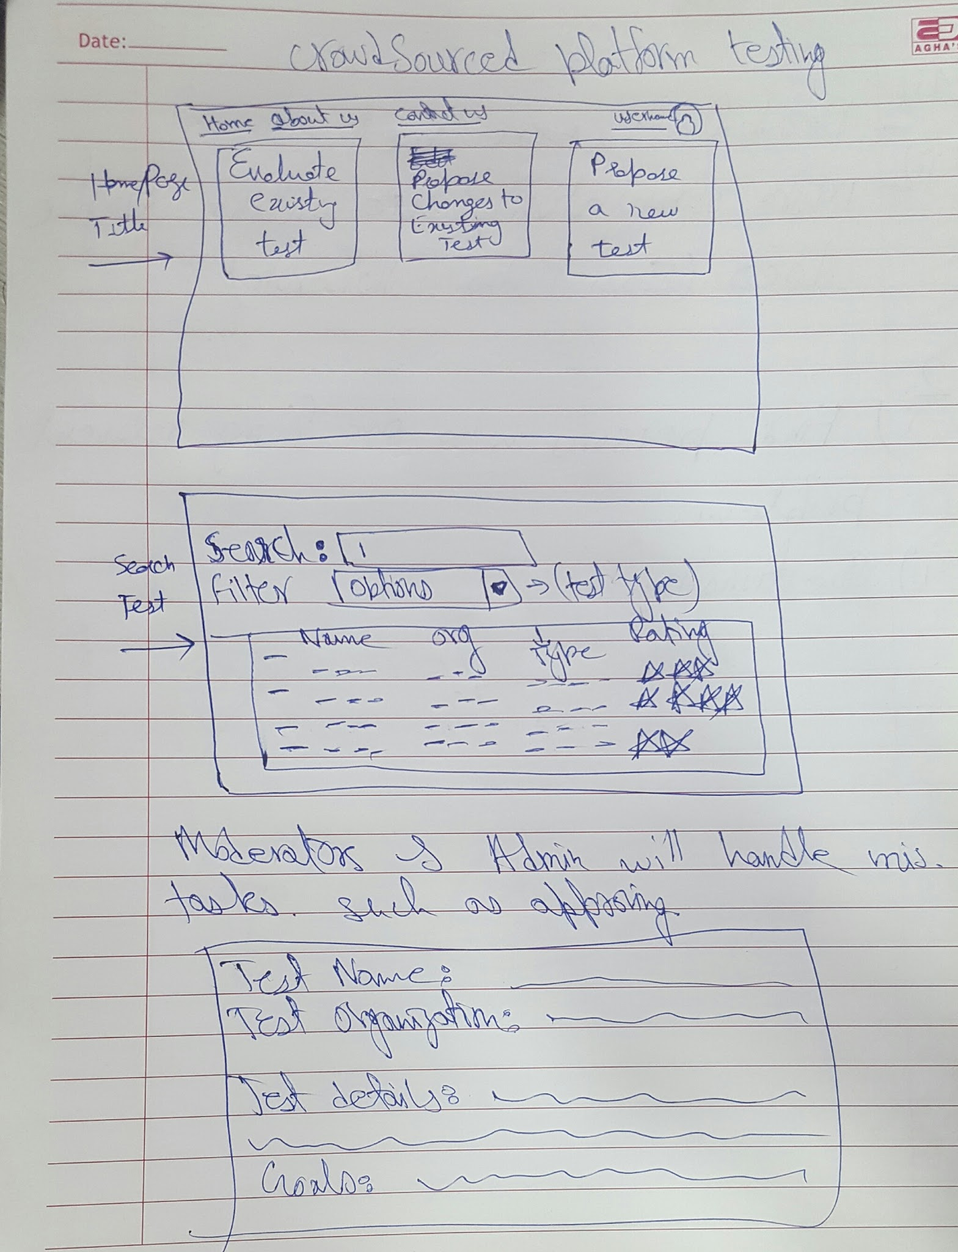
Prototype # 1 Crowdsourced Platform Testing
A platform where public can rate different tests
You can take tests to get recommendations
You can get help and description of tests
User will be able to Propose changes to existing tests

Slide 20
Testing method
Assumption
User wants to test his abilities
User has access to internet
The user will feel that he has made some kind of contribution
Designers will get feedback quickly
Give a brief intro to user
Give a very rough draft of the site
We let them explore, what they can explore, unaided
Let them question design choices and features

Slide 21
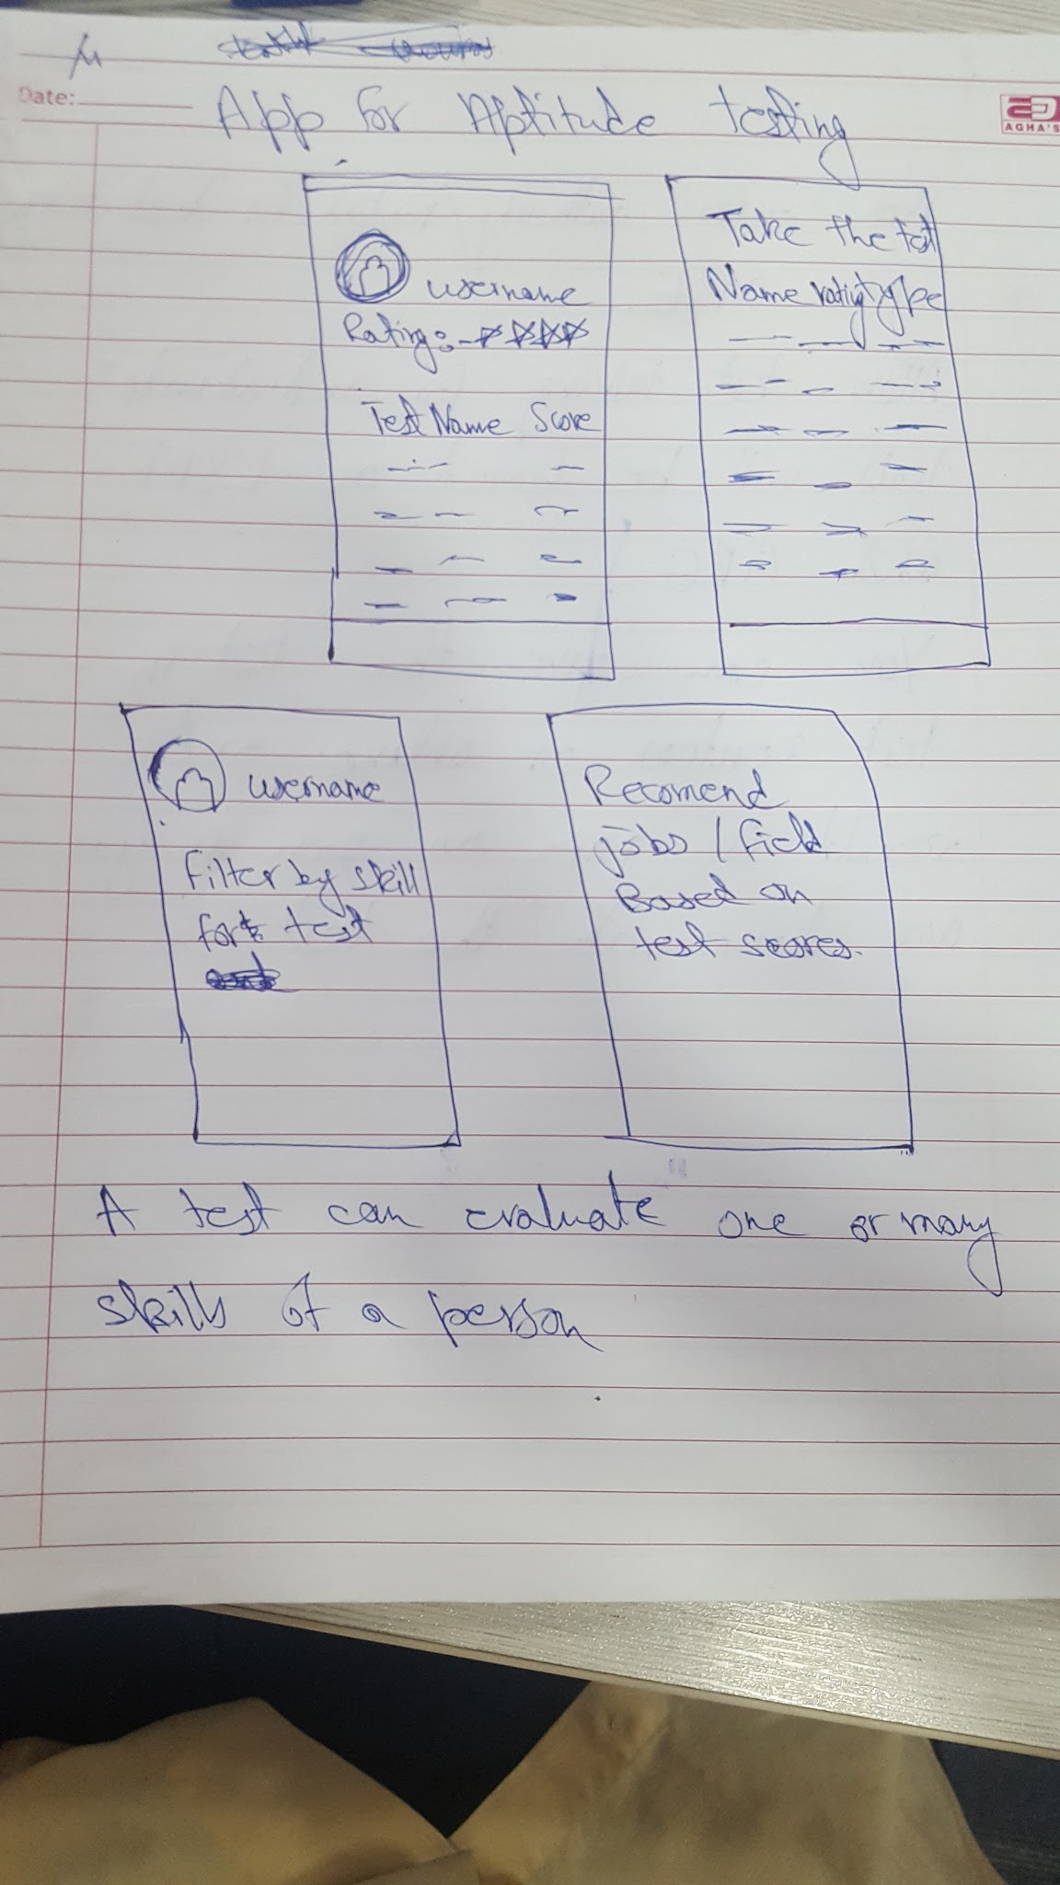
Prototype # 2 App for aptitude testing
Customised tests for predicting performance in
Various Fields
Skill sets
Gives you recommendation of different jobs and different based on score of the test.

Slide 22
Testing method
Assumption
User wants to test his abilities
The user will find appropriate field after giving the exams
Users have smartphone
Test taking experience will be friendly
The app will give a good assesment of his abilities
Give a brief intro to user
Give a very rough draft of the App
Let them question design choices and features
We asked them what they have learned or what they can do from this app

Slide 23
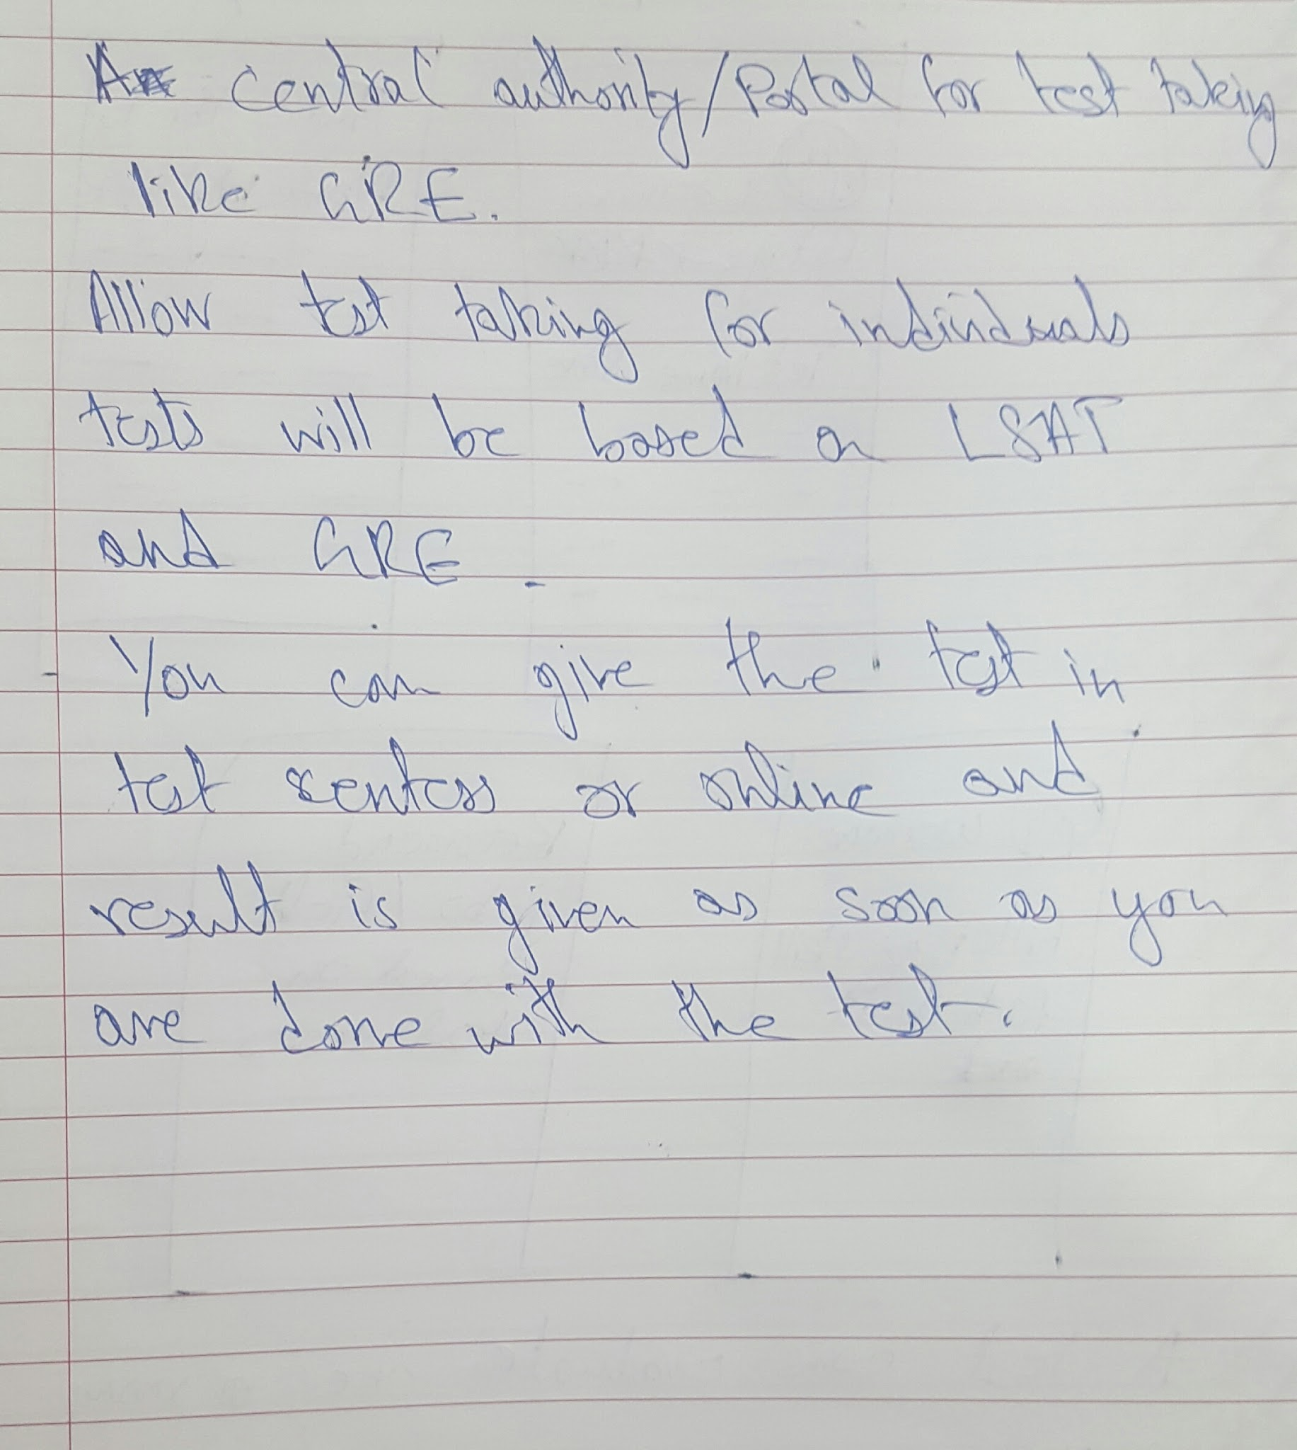
Prototype # 3 An online portal for test taking
The test will be based on GRE/LSAT
Use existing tests for evaluating capabilities and skills.

Slide 24
Testing method
Assumption
The users have access to material for test
The users can afford the test
The users will get result instantly
Give a brief intro to user
Give a very rough draft of the Site
Let them question design choices and features

Slide 25
Surprises and New Learnings
+We can design an informative app for the mobile phone that can give real time notification about other test because users use the phone to stay connected and to remain updated.
-User was hindered by the option for soo many features hence creating a lack of focus
+User were able to extract information about the test by navigating through the website.
-It can be used to prepare the user for the test but not a good medium for conducting test.
+The UI was easy and user was able to carry out the procedure by itself.
-There are many distractions when you try to give a test online by sitting at home or at workplace.

Slide 26
Derived Conclusions
Best Prototype : #1 with slight modification
Reasoning: This is the most productive option out of all the proposed prototypes as it is not severely affected by distractions as others
Why others were not chosen: Mostly because of lack of focus and disturbances that might affect the judgment
Takeaways: Create focused platforms where people can propose and evaluate tests without any test taking features

Slide 27
Questions?

